Slide 1
WEEK 2: LESSON 2
Atomic absorption spectroscopy

Slide 2
Atomic absorption spectroscopy is a related technique to emission spectroscopy, and it can also be used to perform quantitative analysis. i.e. to find the amount of an element present.
AAS uses the absorption of light by electrons in the atom to measure how much of an element present in a sample of substance.

Slide 3
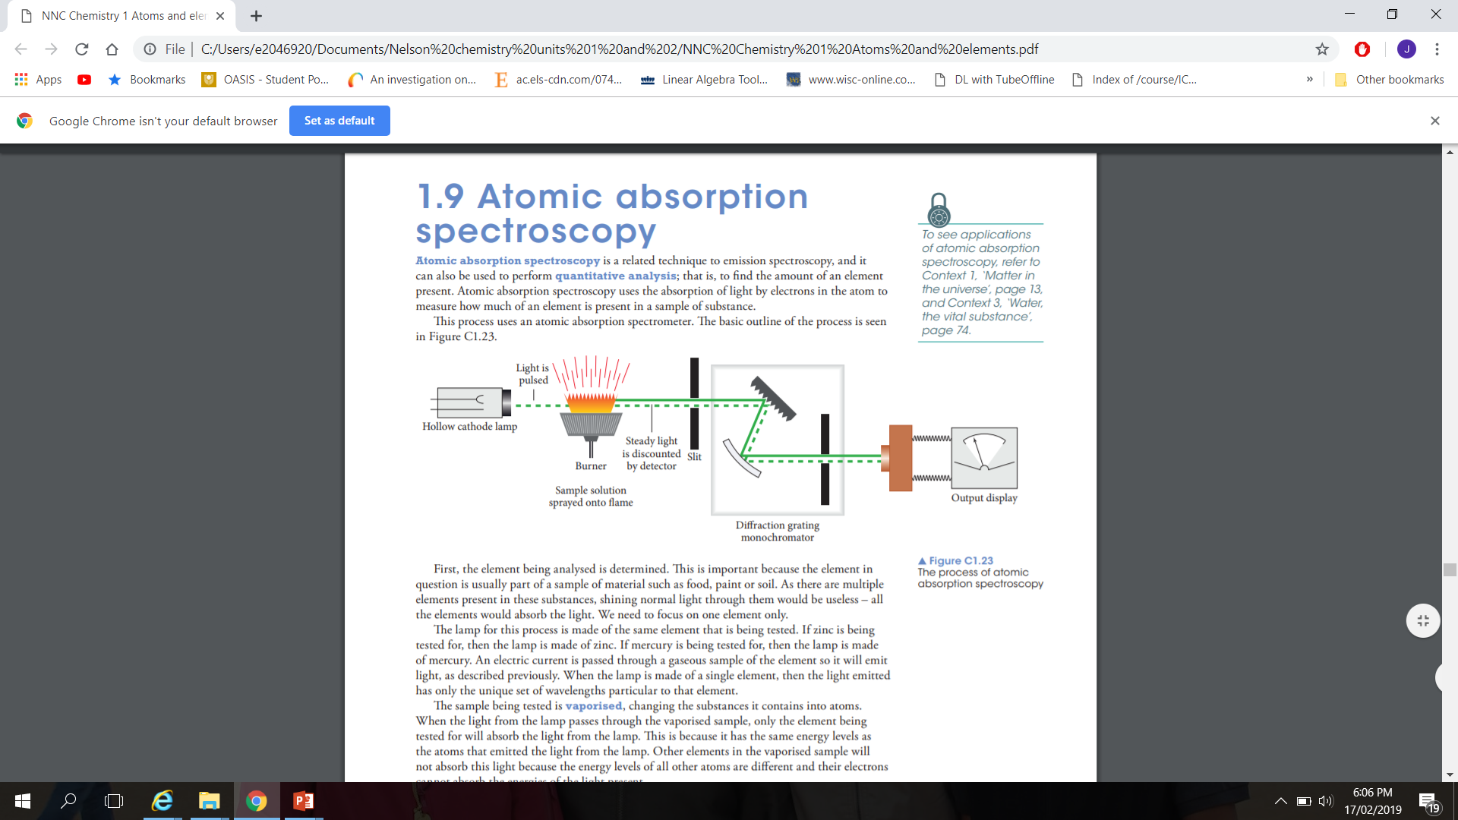
This process uses an atomic absorption spectrometer.

Slide 4
First, the element being analysed is determined. This is important because the element in question is part of a sample of material such as food, paint or soil.
As there are multiple elements are present in these substances, shining normal light through them would be useless. All elements would absorb the light.
We need to focus on one element only.

Slide 5
The lamp for this process is made of the same element that is being tested. An electric current is passed through a gaseous sample of the element so it will emit light.
When the lamp is made of a single element, then the light emitted has only the unique set of wavelengths particular to that element.
Sample being tested is vaporised, changing the substances it contains into atoms. When the light from the lamp passes through the vaporised sample, only the element being tested for will absorb the light from the lamp. This is because it has the same energy levels as the atoms that emitted the light from the lamp.

Slide 6
The light passes through the sample and is focused through a slit before entering a monochromator. This selects just one wavelength of the light for analysis by the detector. The detector measures the intensity of the light, which is displayed as a number. This number is not a concentration but rather a measure of the amount of light that passed through the sample without being absorbed. This is called an absorbance value.
AAS relies on electron transfer between atomic energy levels and can be used to identify elements.

Slide 7
A QUANTITATIVE TOOL
To measure the amount of an element present, the absorbance of the sample is compared to that of known samples. A number of known concentrations of the element are prepared and their intensities are measured by AAS. A calibration curve of concentration against absorbance value can be plotted. This allows the concentration of another sample to be compared and determined once its absorbance is measured.
See worked example in page: 128

